Slide 1
Sustainable Development & Corporate Social Responsibility: An Indian Perspective
Dr. Subhasis Ray
Professor
Xavier Institute of Management
Xavier University
India

Slide 2
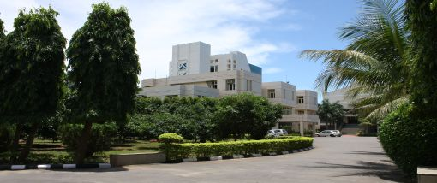

Slide 3
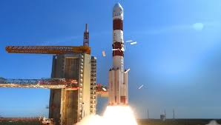
India- A study in contrast
5000+ years of culture, history, philosophy
Fastest growing economy (PwC, 2019)
Top 5 economy
Ease of doing business
Indigenous R&D- space, infrastructure, IT
Economic reforms
Healthcare reforms
Initiatives and progress in renewable energy and sustainable development
Democratic governance

Slide 4
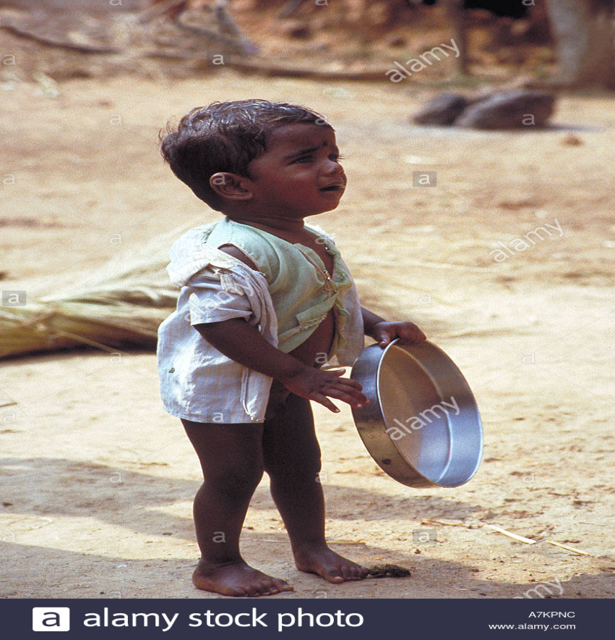
103/118 in Hunger Index

Slide 5
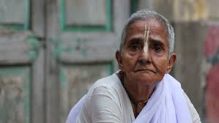
130/189 in Human Development Index

Slide 6
12000+ farmer commit suicide every year

Slide 7
Can business contribute to the social /sustainable developmental goals in India ??

Slide 8
Answer 1
What do you think of this answer ?

Slide 9
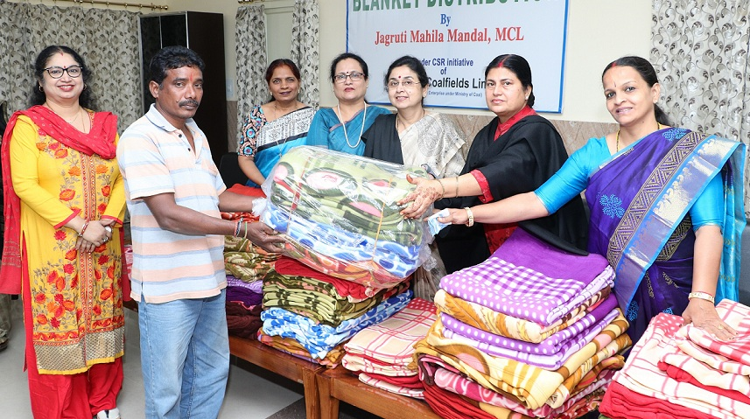
Answer 1
Most CSR expenditure for ensuring last mile connectivity of government schemes in areas related to health & education AND for brand promotion

Slide 10
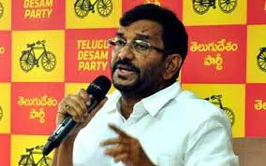
Answer 1
Politics and politician driven CSR

Slide 11
Answer 1
Marketization of CSR

Slide 12
Answer 1
Case Study of the Indian state of Odisha
CSR may increase inequality as companies spend their CSR fund close to their area of operation, ignoring poorer regions

Slide 13
Can business contribute to the social /sustainable developmental goals in India ??

Slide 14
Answer 2
Incubating social enterprise/ hybrid enterprise
Case study of village women making sanitary pads

Slide 15
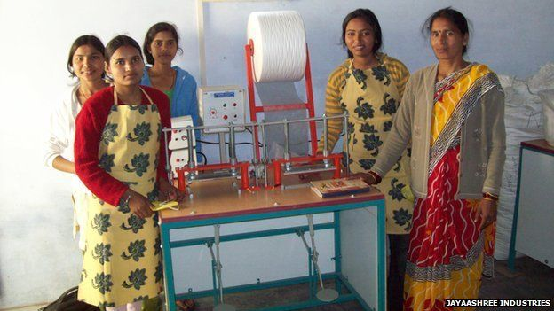
Answer 2
Incubating social enterprise

Slide 16
Answer 2
Findings
Problems of market linkage
Lack of long term corporate interest
Lack of interest in entrepreneurship

Slide 17
Can business contribute to the social /sustainable developmental goals in India ??

Slide 18
Answer 3
Sustainable Production & Consumption
This will require innovation

Slide 19
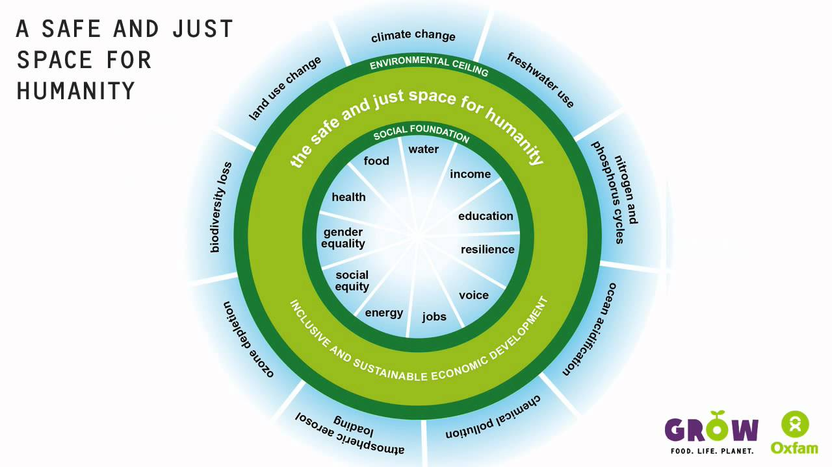

Slide 20
IMPACT focus Performance focus
Healthy Comfort
Energy efficient Power
Non-toxic Speed
Bio-degradable Quality
Renewable Low-cost
Eco-label Performance
Organic ROI

Slide 21
Innovation & Sustainability
1. Regulation driven innovation
(Failure-Telling customers what they should want)
2. Consumer driven innovation
(Failure-May have negative externalities when scaled up)
3. Donor supported Innovation
(Failure-Too small customer group to scale)

Slide 22
Innovation & Sustainability
Sustainable Innovation should be
Good for the system (system thinking)
Good for business investors (business thinking)
Good for Customers (market thinking)

Slide 23
Innovation & Sustainability
Sustainability needs to move from
Technological (product/ process)/ system infrastructure to
Organizational(Delivery & Business Model charging station) to
Institutional (Policy & Market design -tax, regulations) to
Social- (Production & Consumption system (sharing economy)

Slide 24
Business Value Drivers for Sustainability
COST | RISK | REVENUE
Resource Efficiency | Legal | Market Access
Waste as Input | Social/ Reputational | Differentiation
Labor Productivity | Economic/ Operation | New market offerings

Slide 25
Personal
Organizational
Market
Institutional
Socio-Political
Environmental
Are we looking at all levels while decision making ?

Slide 27
Humanistic Technology/ Humanistic Management at the Bottom of the Pyramid

Slide 28
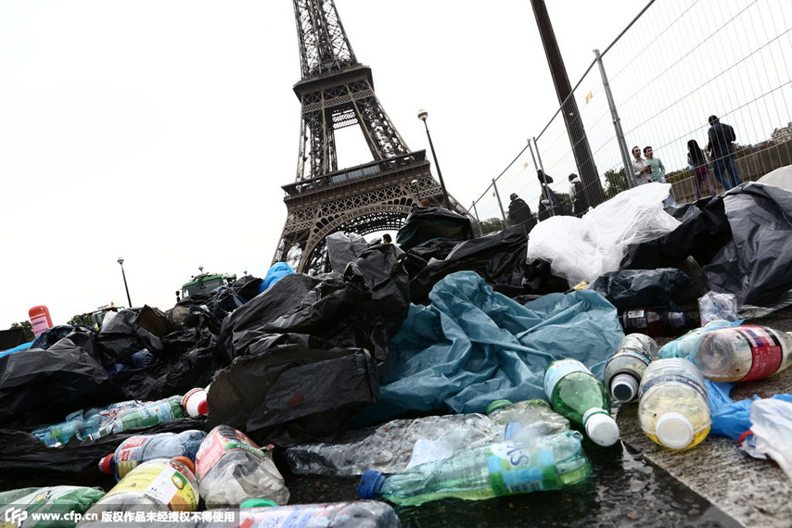
Humanistic Technology/ Humanistic Management at the Bottom of the Pyramid

Slide 29
Humanistic Technology/ Humanistic Management at the Bottom of the Pyramid

Slide 30
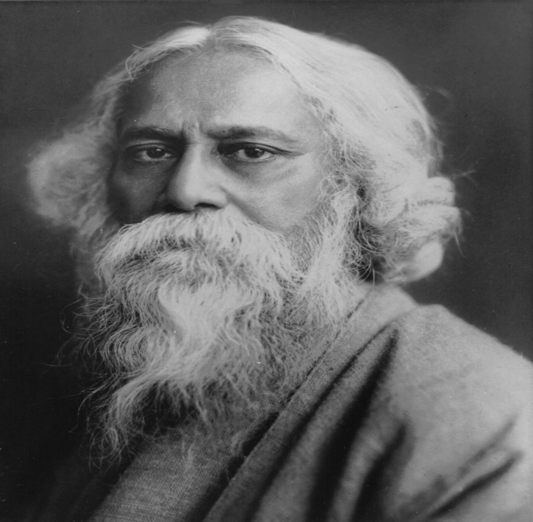
Humanistic Technology/ Humanistic Management at the Bottom of the Pyramid
‘Those whom you have left behind, will always pull you back”

Slide 31
Solving the problem of the poor/excluded will solve the problem of the world

Slide 32
Merci

